Slide 1
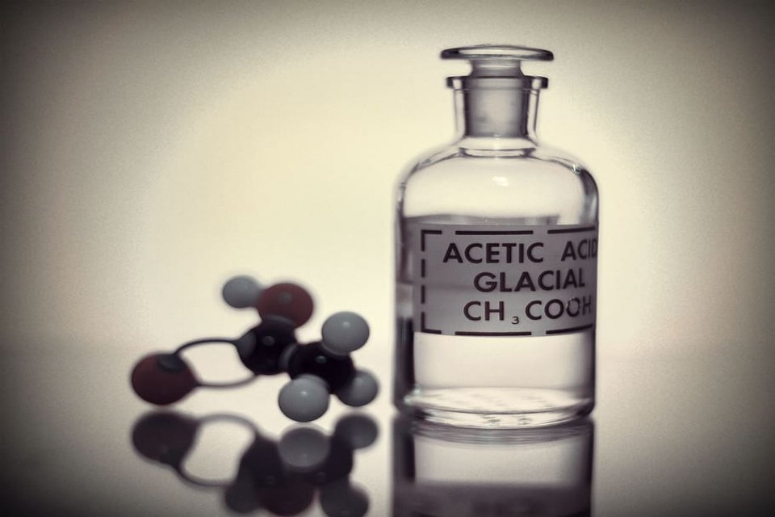
Global Market of Glacial Acetic Acid
Global Supplier Report

Slide 2
Executive Summary
Global Glacial Acetic Acid Market 2016-17 in a Nutshell
2016-17
by Volume
10,000t
Global Glacial Acetic Acid
Market
by Volume
1255 KT
Global Glacial Acetic Acid Manufacturers Market share by Percentage
Global Glacial Acetic Acid Manufacturers
by Geography
Top Global Manufacturers
Celanese Pte Ltd
Chang Chun Group
Kanoria Chemicals
& Industries Ltd
Xi'An Pyson
Biotech Co., Ltd
Lonza Group
2016-17
2016-17

